Slide 1


Digital Advisory & Support Services
Accelerating Digital Evolution for Future-Ready Telcos
January 2025

Slide 2






WHO WE ARE
OUR OPERATIONS SPAN 14 COUNTRIES, WITH MARQUEE ANCHOR PARTNERS KDDI (JAPAN), AT&T (LATAM), AND E& (MIDDLE EAST)
Founded in 2014, Circles has a global presence, operating in 14 countries across 6 continents
Netherlands
UK
OUR STORY
France
Germany
Japan
Tunisia
Since 2021, Circles has evolved into a trusted digital transformation partner to 4 leading operators
Mexico
Pakistan
Colombia
Singapore
Indonesia
Brazil
South Africa
Australia
‹#›

Slide 3
Make it more visual
DIGITAL TRANSFORMATION IS A HUGE AND COMPLEX UNDERTAKING FOR OPERATORS
Over 70% of internally-led digital transformation projects fall short of their objectives.¹ These projects, spanning 2–4 years, strain businesses’ resources and budgets, as new systems are managed alongside legacy ones. Success requires not just technological upgrades, but business transformation, backed by a compelling business case to enhance customer value, growth and operational efficiency.
LEGACY MINDSET
WEAK ENGAGEMENT
LACKLUSTRE INNOVATION
Evolving into a digital operator requires a fundamental change in organizational mindsets, skill-sets, systems and processes
Fostering loyalty and a deeper connection with customers requires a redesign of the customer experience across digital and physical touchpoints
With telco and digital boundaries blurring, digital telcos need to re-invent business models and build strong ecosystems to differentiate themselves
Note:
1. Source: BCG study
‹#›
Notes:
Sources: https://www.bcg.com/publications/2024/five-recipes-for-failure-in-telco-transformation

Slide 4
Make it more visual
THE CIRCLES PROPOSITION
Best-in-class capabilities
We equip our partners and their teams with strategic and operational expertise and know-how in critical strategic and operational functions¹ across the business.
Circles delivers innovative and scalable solutions
for our partners worldwide
Customer-centric design
We empower our partners to achieve long-term success by re-designing the world-class ‘phygital’ consumer experience, drawing from our experience as a global digital operator.
Transformative solutions
We re-imagine business models and commercial processes, capitalizing on new technologies and partnerships to drive organizational change and enable sustainable business growth.
Note:
1. Including, but not limited to, business strategy, digital marketing, customer value management, NPS, and partnerships
‹#›

Slide 5
Insert graphics for each vertical
OUR SERVICES
CIRCLES OFFERS SERVICE MODULES ACROSS FIVE FUNCTIONAL CATEGORIES
BUSINESS STRATEGY & PERFORMANCE
VALUE PROPOSITION & PARTNERSHIPS
BRAND &
GROWTH MARKETING
CUSTOMER VALUE MGMT. & ANALYTICS
OPERATIONS &
CUSTOMER HAPPINESS
‹#›

Slide 6
Make it more visual, e.g., insert graphic on right
OUR SERVICES
SERVICE MODULES
Business Strategy & Performance
1 | Business Strategy
Market and segment sizing
Competitive review and analysis
Business model innovation
2 | Business Planning
Business plan and forecast modeling
Scenario planning and analysis
Target-setting and budgeting
3 | Commercial Operations
Market review and diagnostics
Pricing strategy and governance
Phygital channel strategy
‹#›

Slide 7
Make it more visual, e.g., insert graphic on right
OUR SERVICES
SERVICE MODULES
Value Proposition & Partnerships
1 | Consumer Value Proposition
Target segment definition
Primary market and consumer research
Product and proposition development
2 | Partnerships and Ecosystem
Partnerships strategy and framework
Loyalty program design
Lifestyle ecosystem design
3 | Innovation Engine
New product and growth experimentation
Rapid prototyping and testing in-market
Scalable solution development
‹#›

Slide 8
Make it more visual, e.g., insert graphic on right (similar to previous slides)
OUR SERVICES
SERVICE MODULES
Brand & Growth Marketing
1 | Go-to-Market
Channel mix planning
Demand generation and funnel mgmt.
Digital marketing strategy
4 | Performance Marketing
Data-driven advertising campaign planning
Targeted audience outreach strategies
Marketing investment optimization
2 | Brand and Creative
Brand positioning strategy
Brand health tracking and diagnostics
Creative and communications planning
3 | Martech, Website Development and SEO
Martech setup and platform integration
Website design and development
Search engine optimization initiatives
‹#›

Slide 9
Make it more visual, e.g., insert graphic on right
OUR SERVICES
SERVICE MODULES
Customer Value Mgmt. & Analytics
1 | Subscriber Management and CVM
Subscriber lifecycle management
Customer value optimization (data analytics)
Retention and loyalty program design
2 | Advanced Analytics
Customer segmentation and profiling
Predictive churn modeling and forecasting
Performance tracking and reporting
‹#›

Slide 10
Make it more visual, e.g., insert graphic on right
OUR SERVICES
SERVICE MODULES
Operations & Customer Happiness
1 | Operations Planning and Support
Logistics partner evaluation
Operational process setup
Operational efficiency initiative planning
2 | Customer Happiness Service Support
BPO agent partner evaluation
BPO force setup and training
BPO force management and optimization
3 | Net Promoter Score (NPS) Management
NPS reporting and tracking
Detailed customer feedback analysis
Actionable insights to improve satisfaction
‹#›

Slide 11
Make it more visual
OUR ENGAGEMENT MODEL
CIRCLES OFFERS THREE ENGAGEMENT MODELS
TAILORED TO CLIENTS’ BUSINESS NEEDS AND SKILL-SET GAPS
LITE
Advisory Services
SUPPORT
Implementation Services
PREMIUM
Build and Operate Services
Workshops: Facilitate ideation sessions and workshops to co-create solutions
Consulting services: Provide data-driven insights and strategic guidance on market entry and digital-first strategy and operations in navigating the complexities of digital transformation
Strategy-to-execution support: Hands-on assistance for our clients in executing on strategic initiatives that align with broader transformation goals
Real-time issue resolution: Troubleshoot issues and adapt strategies in real-time to meet timelines and tactical objectives
Embedded partnership: Specific and measurable outcome ownership and output for focus workstreams¹
Team set-up: Establish and operationalize functions, in alignment with business plan
Capability-building: Develop and train client teams, ensuring skills transfer and eventual ability to operate independently
Note:
1. Examples of outcomes include marketing investment ROI, non-telco revenue growth, customer win-back rate, etc.; senior-level expert support provided
‹#›

Slide 12

Make it more visual, add graphic related to Wim on right
OUR TRACK RECORD: CASE STUDIES
LITE (LAUNCH) // PREMIUM (POST-LAUNCH)
Mexico • AT&T Mexico
Engagement highlights
Marketing | Multiple areas
Designed and executed performance marketing strategies (paid and organic strategies)
Developed creative and promotional strategies
Business Planning | Scenario Planning
Developed scenario planning analyses across different proposed business cases
Consumer Value Proposition
Developed and tested new value propositions post-launch, based on consumer feedback
Customer Value Management | Churn management
Designed win-back and churn reduction strategies
Launched
September 2024
Premium Services engagement commenced
October 2024
Outcomes
98% increase
in daily acquisition run-rate in < 3 months
‹#›
Notes:
Daily GA run-rate for GAs in Dec’24 - 87/ day (total ~2.7k GAs in Dec’24)
Prior to engagement of Circles team for Premium Services on 7 Oct’24, GA run-rate was ~44/day (25 Sep’24 @ launch - 6 Oct’24)
This is even higher than the 50 / day run-rate experienced in first week post-launch (after marketing investment)

Slide 13

OUR TRACK RECORD: CASE STUDIES
LITE (LAUNCH) // PREMIUM (OPERATIONS)
Japan • KDDI
Engagement highlights
Capability Building and Launch Readiness Support
Equipped in-market team with Circles’ playbooks, process manuals¹ and best practice case studies across digital marketing, customer experience, and operations
Transfer of functional expertise in attracting and retaining digital talent via cross-training and collaboration
Consumer Value Proposition | Launch proposition design
Designed customer journeys and value propositions (e.g., freemium construct to counter competitor Rakuten)
Introduced and launched the ‘Xplore’ lifestyle feature to diversify revenue streams beyond telco core
Launched
October 2021
Outcomes
1 million active users
in 18 months
55% improvement
in churn reduction to 1.3%
15-point improvement
in customer NPS
Note:
1. Playbooks refer to strategic frameworks on why we win; Process manuals refer to SOPs on how we win
‹#›

Slide 14

Make it more visual, add graphic related to onic on right
OUR TRACK RECORD: CASE STUDIES
PREMIUM (LAUNCH)
Pakistan • e& International
Engagement highlights
Business Strategy and Execution
Business strategy and go-to-market planning (including market sizing, new brand strategy, launch rollout strategy, teaser campaign concept and creative strategy)
Business Planning and Budget Negotiations
Developed financial forecast and returns analysis for the five-year strategic partnership across base, optimistic and conservative scenarios
Consumer Value Proposition
Developed launch proposition, based on consumer studies and hypothesis testing (e.g., conjoint analysis)
Team Setup and Capability Building
Recruited and trained the in-market functional leaders
Launched
August 2023
Outcomes
230K waitlist signups
over 1-month teaser campaign (+20% over target)
30% conversion
on Day 1 of launch
(for first batch of 10K waitlist signups)
‹#›
Notes:
Go-to-Market
Value Proposition
Team setup and capability building

Slide 15

Make it more visual, add graphic related to Circles.Life on right
OUR TRACK RECORD: CASE STUDIES
PREMIUM (OPERATIONS)
Singapore • Circles.Life
Engagement highlights
Brand & Marketing | Brand strategy revamp
Initiated and led a major revamp for the Circles.Life brand in Singapore from strategy to execution
Consumer Value Proposition | Innovation
Conceptualized and implemented experimental growth initiatives, including new business models, targeted campaigns, and new non-telco verticals
Commercial Operations | Phygital channel execution
Launched retail wallet digitize and streamline Circles.Life retailers’ experience
Customer Value Management & Analytics
Rolled out new data platform and developed new monthly diagnostic review of business performance
Outcomes
38% increase in site traffic
from launch of ‘Do Your Own Thing’ brand campaign
(targeted at digital-savvy youth)
S$1 million
new non-telco revenue stream
built in 9 months
~23% MoM increase
in acquisitions from phygital strategy
‹#›
Notes:
Targeted campaigns - e.g., “Claim What’s Yours”
New business models - “Race to Zero”

Slide 16

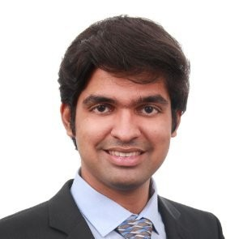
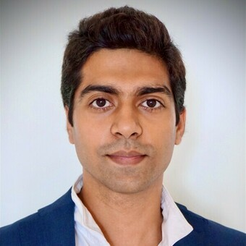

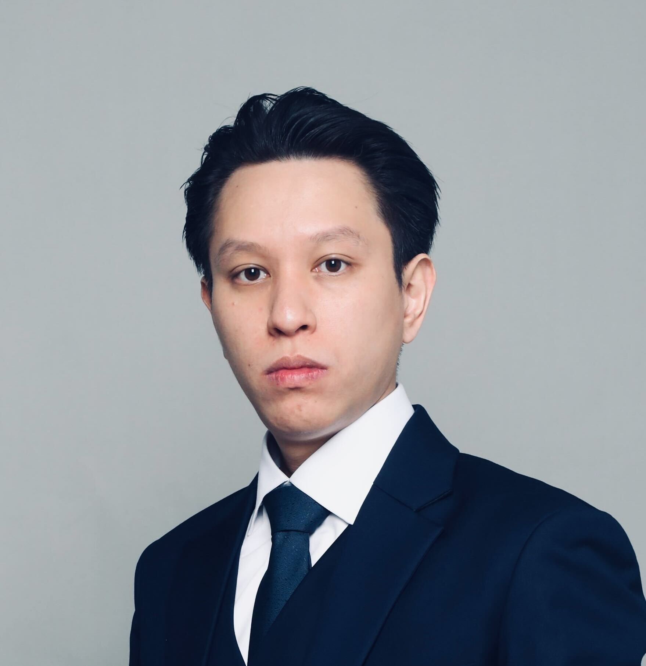
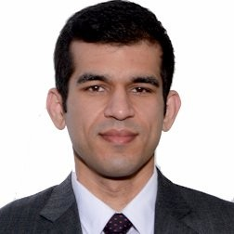
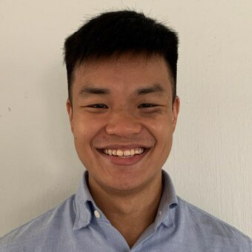

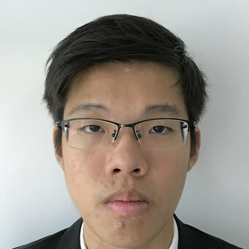
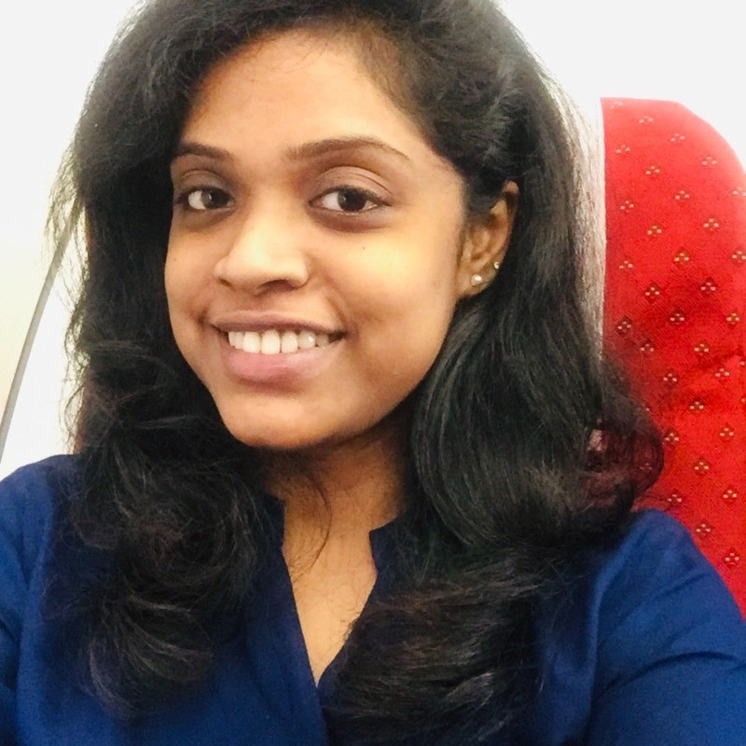
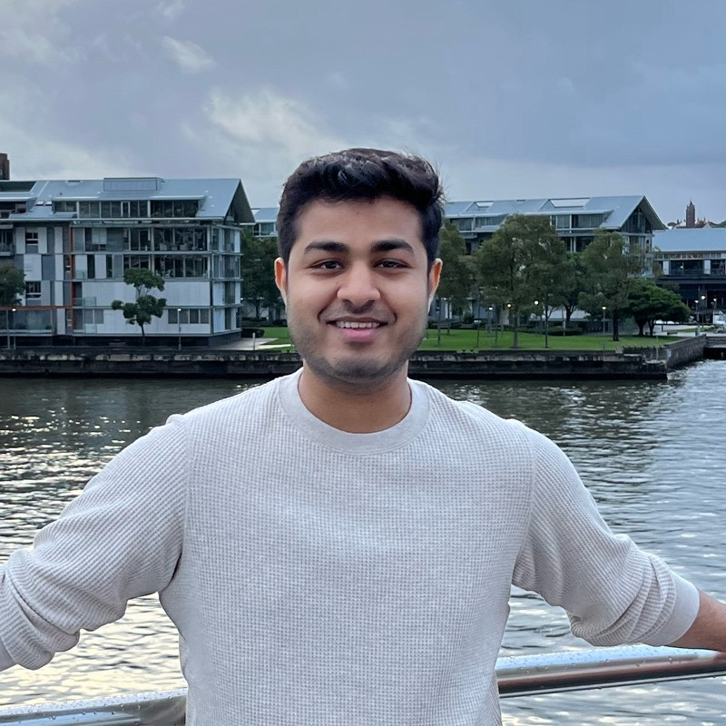










Can make it neater / insert some graphics
OUR TEAM
WE HAVE A TEAM OF EXPERTS WITH THE RIGHT MIX OF OPERATOR AND CONSULTING EXPERIENCE
Business Strategy & Performance
Value Proposition & Partnerships
Brand &
Growth Marketing
Umar Tanwir
Vice President, Strategy & Performance
Bhadri Ramachandran
Director, Proposition & Partnerships
Ajay Sampath
Vice President, Consumer Marketing
SPECIALISTS
SPECIALISTS
SPECIALISTS
EXPERIENCE
EXPERIENCE
EXPERIENCE
‹#›

Slide 17
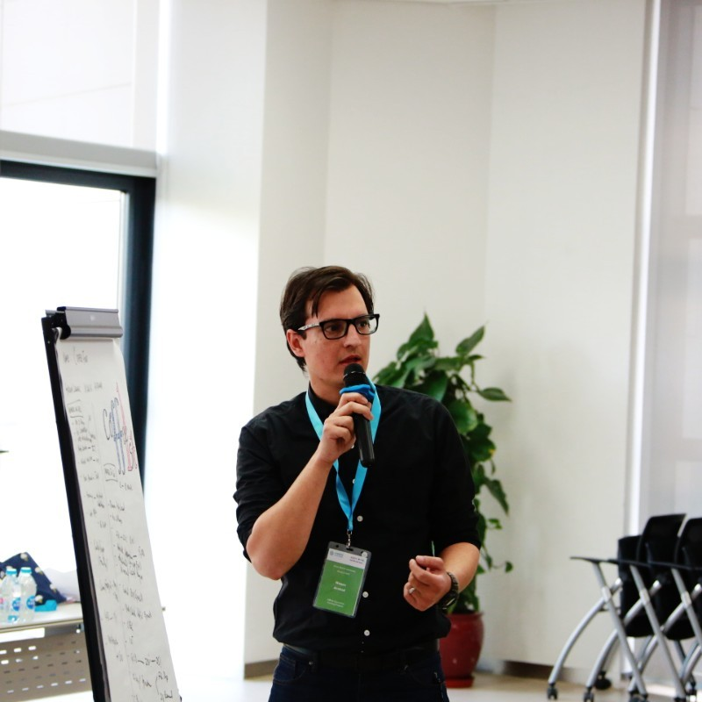
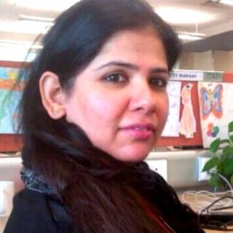
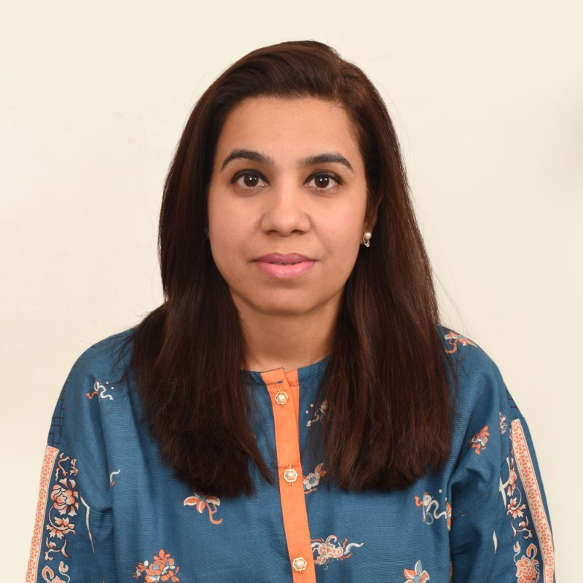
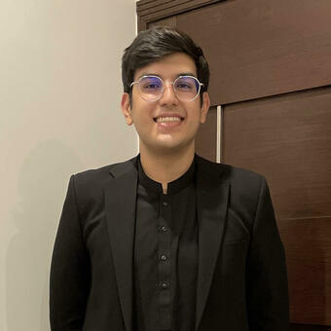

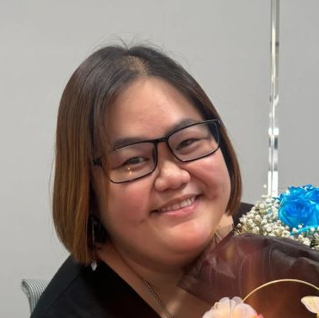
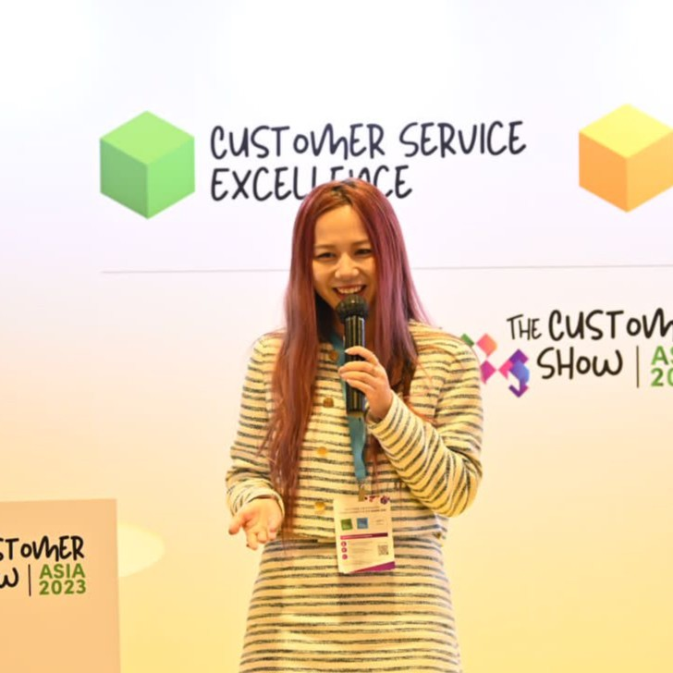
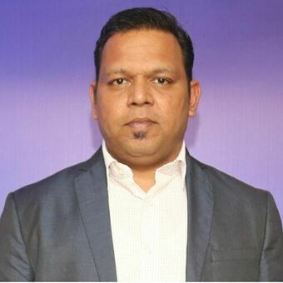


Can make it neater / insert some graphics
OUR TEAM
WE HAVE A TEAM OF EXPERTS WITH THE RIGHT MIX OF OPERATOR AND CONSULTING EXPERIENCE
Customer Value Management & Analytics
Operations & Customer Happiness
Waqas Arshad
Director, CVM & Data Strategy
Honey Madaan
Head, Customer Experience
SPECIALISTS
SPECIALISTS
EXPERIENCE
EXPERIENCE
‹#›

Slide 18
Thank you!

